Slide 1

MIAI504 501
Neural networks and Deep Learning
  MIAI504 – 2026/2027
Dr. Zein Al Abidin IBRAHIM
zein.ibrahim@ul.edu.lb

Slide 2
neural networks:
A Quick overview
DEEP LEARNING

Slide 3
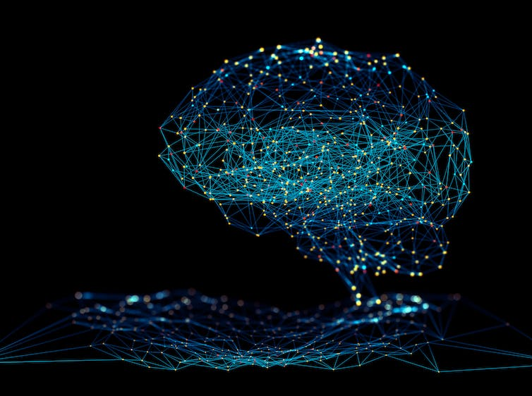
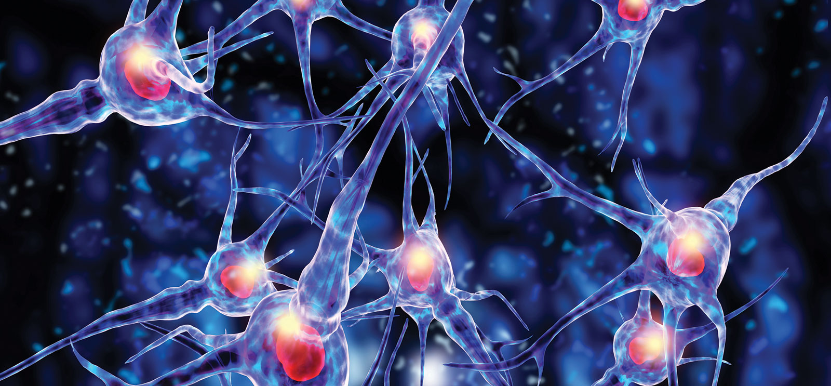
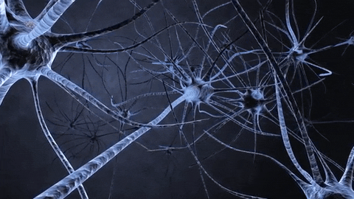
Brain

Slide 4
What is Neural Networks ?
Idea → inspired from human Brain
A brain is composed of a vary large number of processing units → called neurons.
Number approximately = 10¹¹ = 10 milliard neurons
Neurons works in parallel ⇒
  Computational power of brain is very high
  In addition → large connectivity of neurons
Connections called synapses
Neurons have connections to around 10⁴ other neurons.
Brain take approximately 100-200ms to perform perceptual recognition

Slide 5
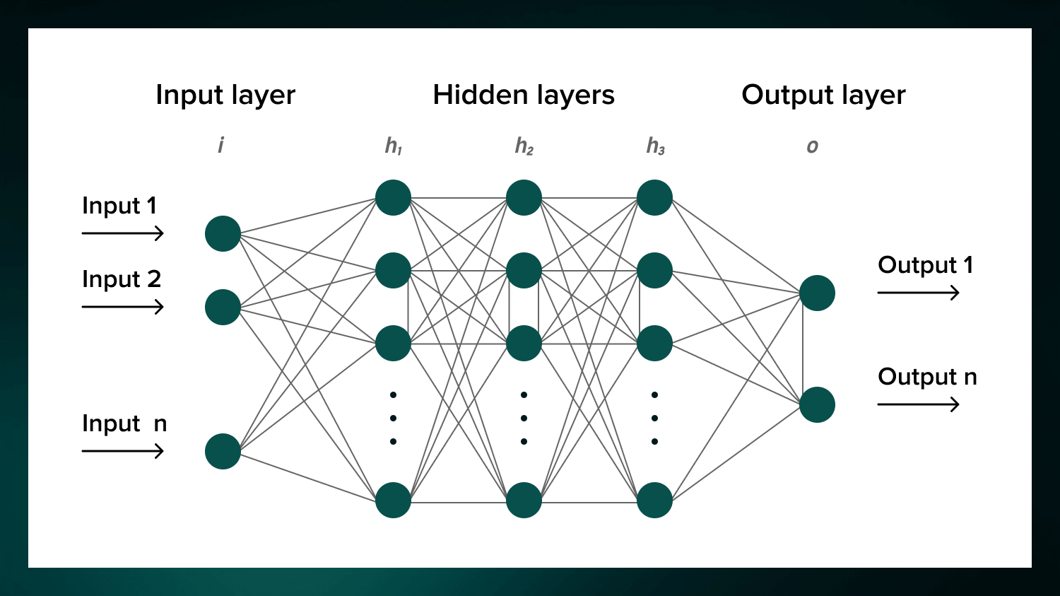
What is ANN?
ANN → massive number of parallel distributed processing units
Can store experiential knowledge (experiences)
Similar to brain in two main things:
  Knowledge → acquired from its environment through a learning phase.
  Interneuron connection weights used to store the acquired knowledge.

Slide 6
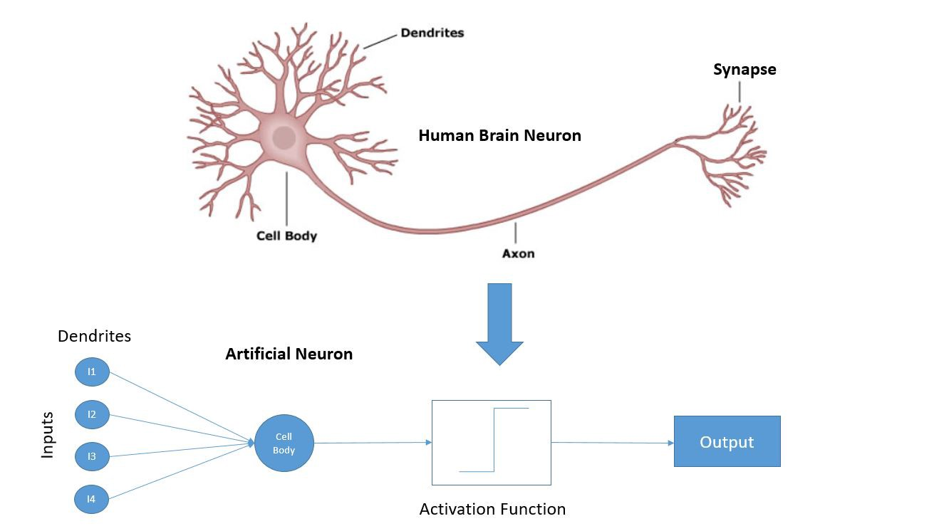
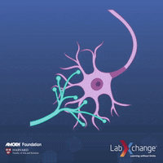
Looking Inside Human Brain

Slide 7
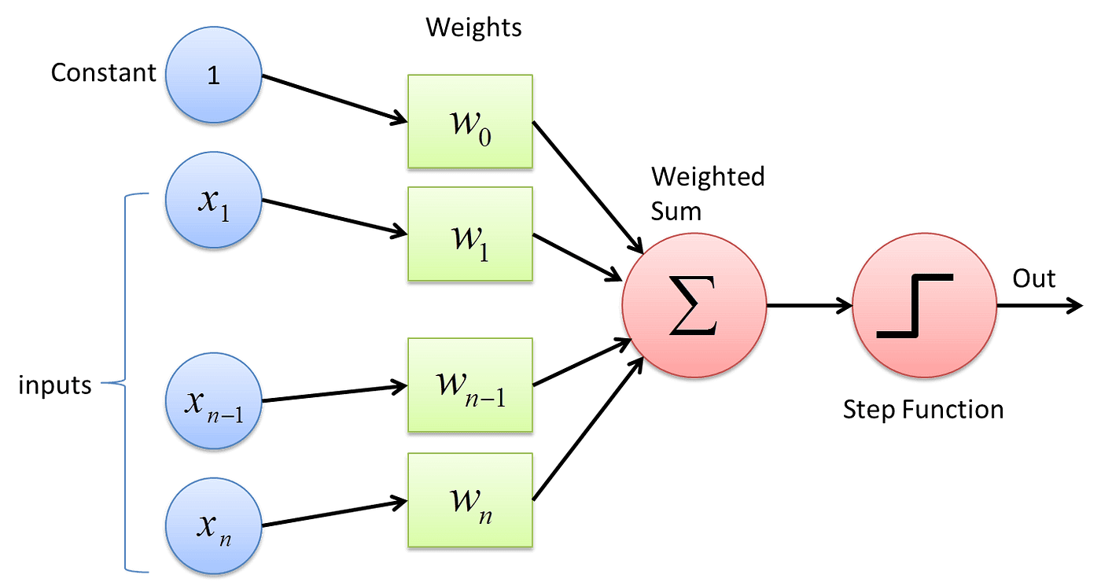
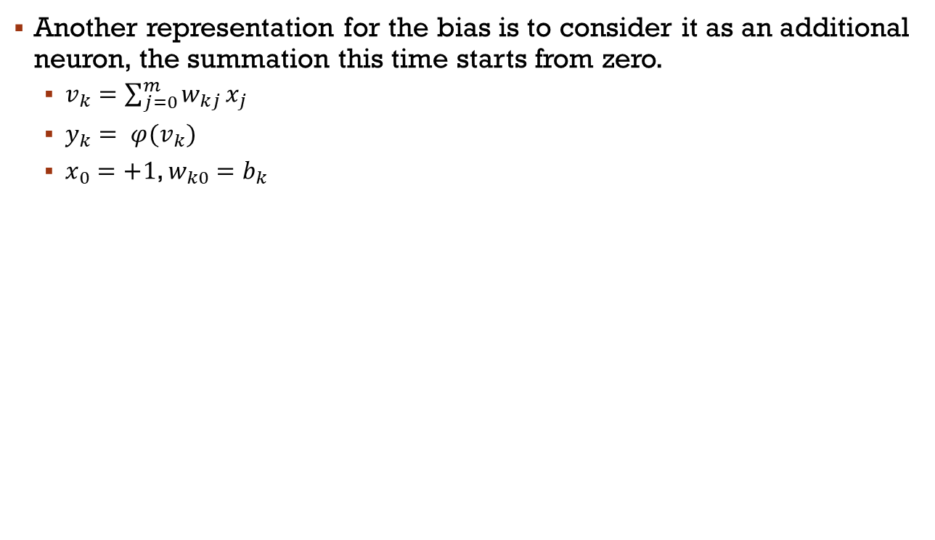
How to Model a Neuron
Another representation for the bias is to consider it as an additional neuron, the summation this time starts from zero.
  $v_{k}=\sum_{j=0}^{m}{w_{kj}}x_{j}$
  $y_{k}= φ(v_{k})$
  $x_{0}=+1$, $w_{k0}=b_{k}$

Slide 8
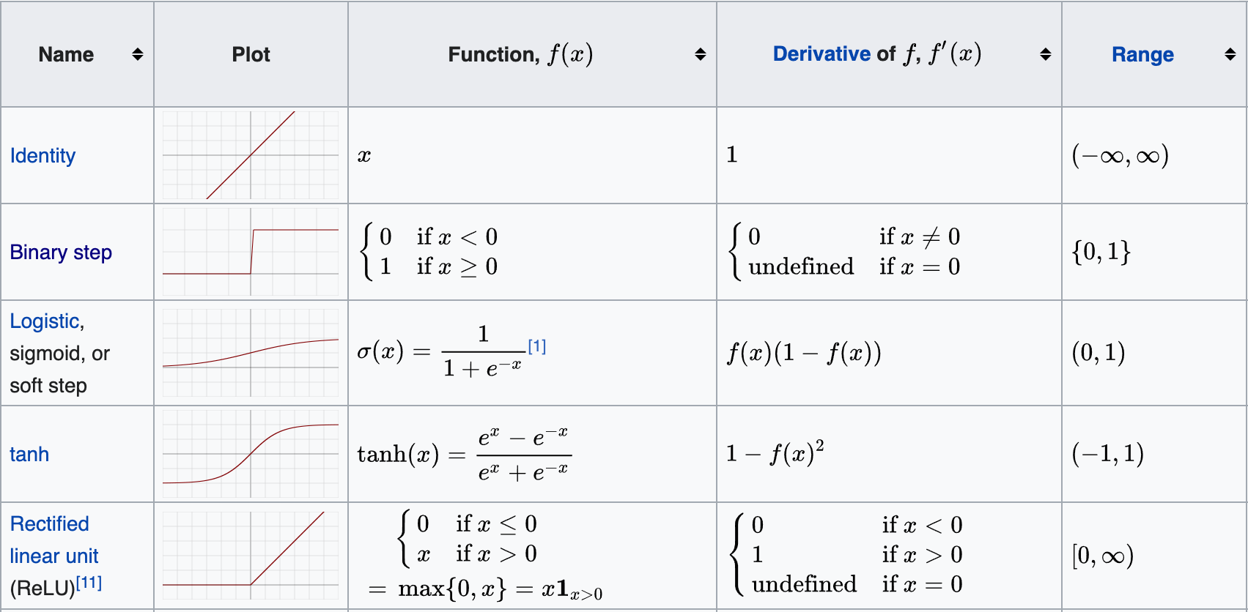
Some activation functions
Notes:
1. **Non-Linearity:** Activation functions allow the neural network to model non-linear relationships. Without non-linear activation functions, the network would simply behave like a linear regression model, regardless of the number of layers.
2. **Feature Learning:** They enable the network to learn intricate patterns by transforming the input signals into different ranges, helping to capture essential features in the data.
3. **Output Regulation:** Activation functions normalize the output of each neuron to a specific range, which can facilitate the convergence during training and improve the stability of the model.
4. **Enabling Deep Learning:** By introducing non-linearity, activation functions allow deep neural networks, which include many layers, to approximate complex functions and solve complicated tasks.

Slide 9
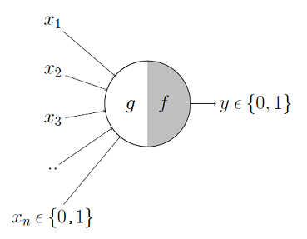
McCulloch-Pitts model
The first computational model of a neuron was proposed by Warren MuCulloch (neuroscientist) and Walter Pitts (logician) in 1943.
Inputs → Boolean
Output → Boolean
Activation → thresholding
What we can do with → OR, AND, NOT
No learning from data
Just a theoretical model

Slide 10
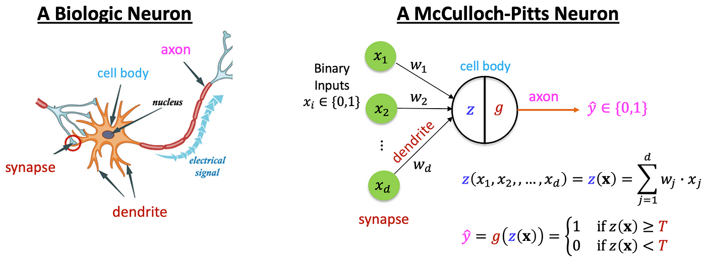
McCulloch-Pitts model

Slide 11
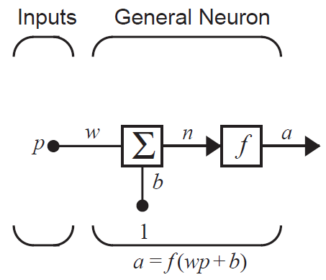
One-input Neuron: Example
  1D pattern p
  The associated weight = w
  The bias value is b
  The output is n
  The value n passes through the activation function f to generate the output a
  Ex: w=3, p=2, b=-1.5 ⇒
    a=f(3(2)-1.5)=f(4.5)

Slide 12
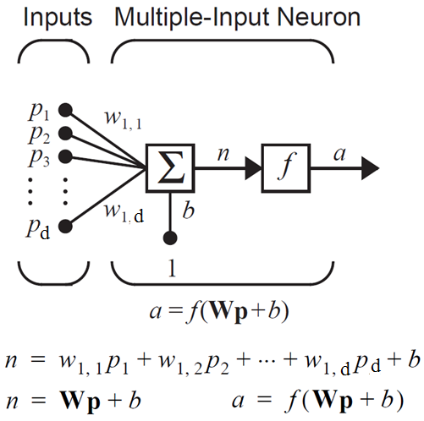
Multiple-input Neuron: Example

Slide 13
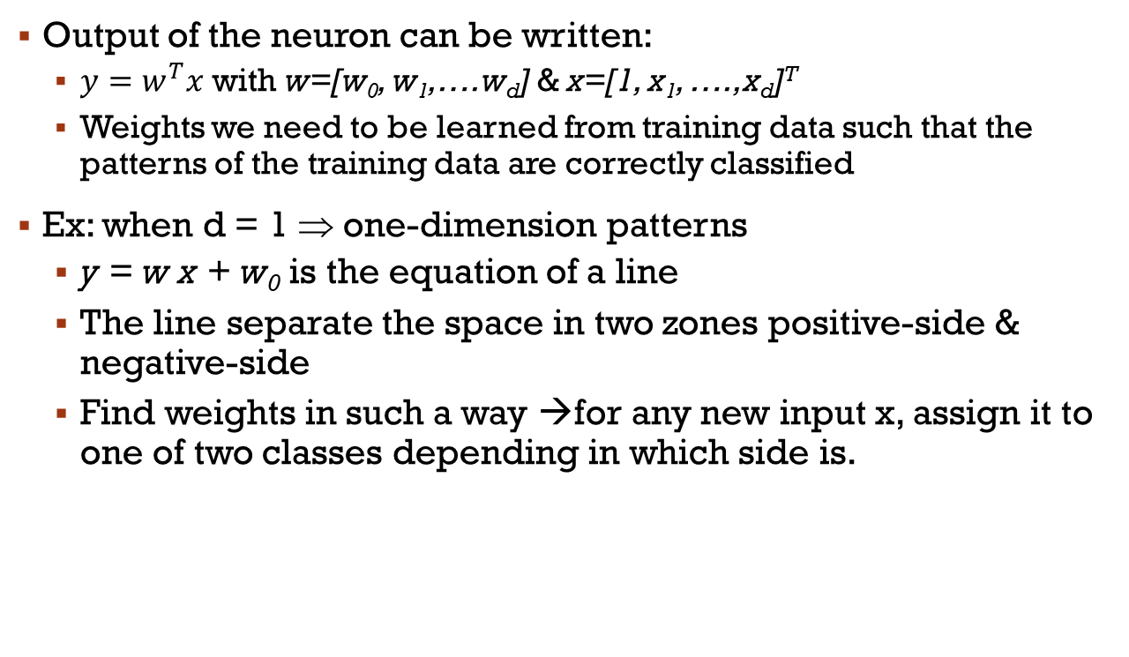
The Neuron in the Space
Output of the neuron can be written:
  $y=w^{T}x$ with w=[w₀, w₁,….w_{d}] & x=[1, x₁, ….,x_{d}]^{T}
  Weights we need to be learned from training data such that the patterns of the training data are correctly classified
Ex: when d = 1 ⇒ one-dimension patterns
  y = w x + w₀ is the equation of a line
  The line separate the space in two zones positive-side & negative-side
  Find weights in such a way →for any new input x, assign it to one of two classes depending in which side is.

Slide 14
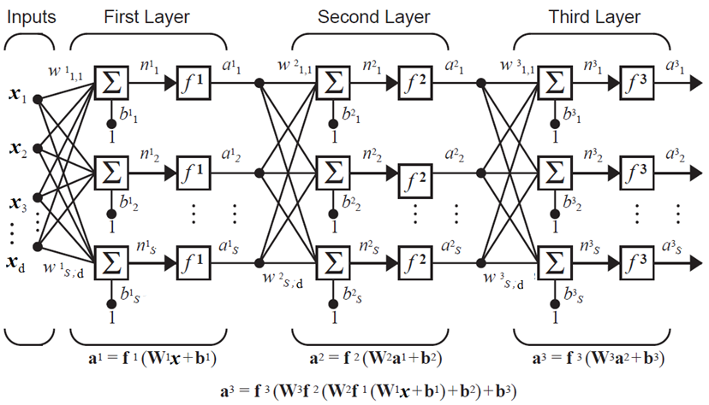
How to represent a Neural Networks: directed Graphs
… … …

Slide 15
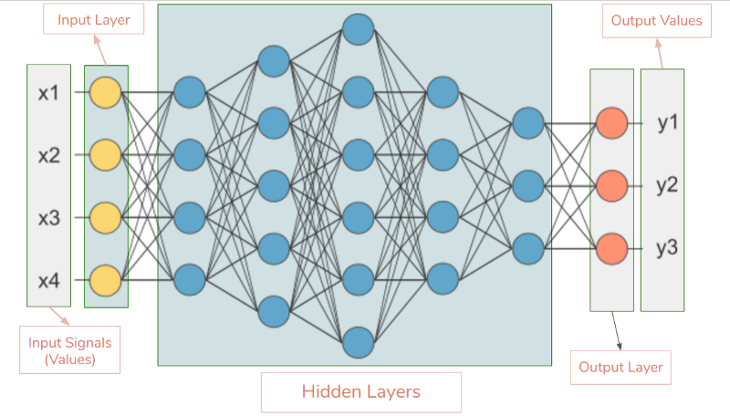
How to represent Neural Networks: directed Graphs
The directed graph can be complete (known as fully-connected or dense) or incomplete.
  Fully-connected → each neuron in layer n is connected to each neuron in layer n+1 (see figure below).
  Incomplete (known as partially complete)→ a neuron in layer n is connected to some neurons in layer n+1 (used in CNN, RNN, …).
    referred to as an architectural graph

Slide 16
Some Network Architectures (1/2)
Here are some network architectures:
  Feedforward Neural Networks (Multilayer Perceptron (MLP))
    Used in simple classification and regression tasks where the input data is structured.
  RNN → Recurrent Neural Networks
    Used in NLP for time-series prediction, speech recognition, and any task where order and context over sequences are important.
  CNN→ Convolutional Neural Networks
    Used in image and video recognition, object detection, segmentation, and any task involving visual data.
  LSTM → Long Short-Term Memory Networks
    Similar to RNNs but more efficient for longer sequences and temporal dependencies. Used extensively in NLP tasks, machine translation, and speech processing.
  Transformer Networks
    Transformer networks use attention mechanisms to process input data, enabling them to capture global dependencies in sequences of data.
    Used in NLP tasks such as translation, summarization, and language modeling (e.g., BERT, GPT). Used also in image processing (Vision Transformers).

Slide 17
Some Network Architectures (2/2)
Here are some network architectures:
  GAN → Generative Adversarial Networks
    Consists of two neural networks, a generator and a discriminator, that compete against each other in a zero-sum game.
    The generator creates fake data, and the discriminator tries to distinguish between real and fake data.
    Used for image generation, style transfer, data augmentation, and synthetic data generation for various applications.
  Autoencoders
    Consists of an encoder and a decoder. The encoder compresses the input into a latent-space representation, and the decoder reconstructs the input from this representation.
    Used for dimensionality reduction, image denoising, anomaly detection, and generating data (e.g., variational autoencoders).
  Graph Neural Networks (GNN)
    designed to work with graph-structured data. They use nodes, edges, and adjacency matrices to process data.
    Used for Social network analysis, molecular biology, recommendation systems, and any application involving network or graph-structured data.
  Capsule Networks (CapsNets)
    attempt to model hierarchical relationships in data more effectively than traditional CNNs.
    Used for image classification, object segmentation, and tasks requiring spatial hierarchies in the data.
  ...

Slide 18
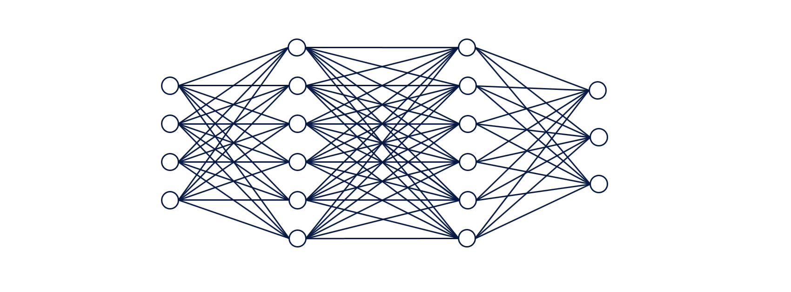
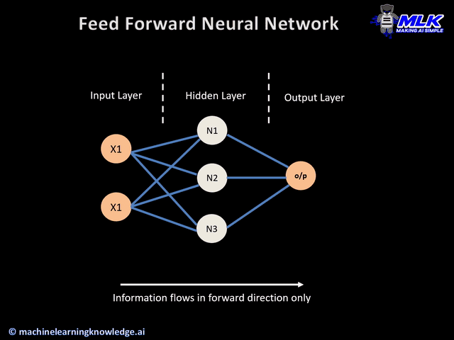
Feedforward Network

Slide 19
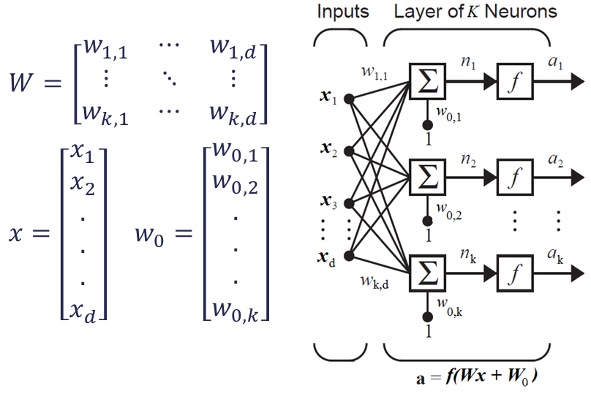
Single-layer and multi-layer

Slide 20
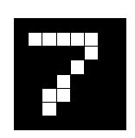
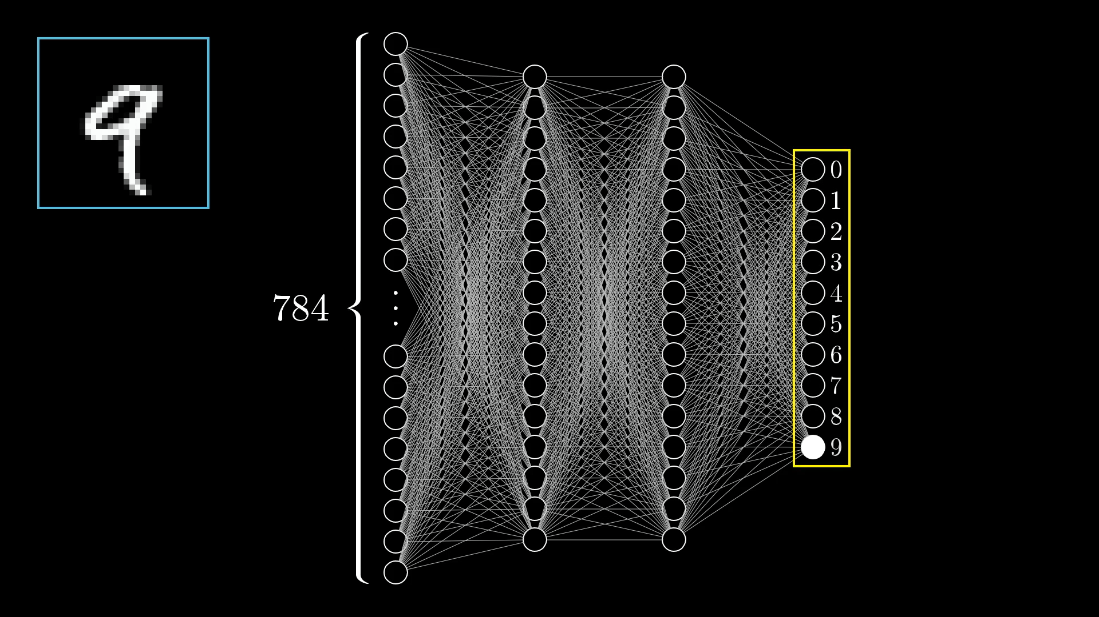
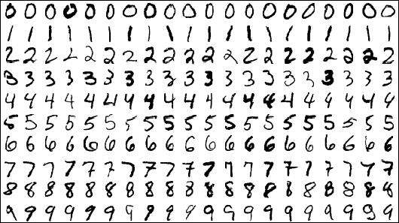
Example – Use case
Consider a handwritten-digit recognition problem.
  Input → pixels of the image each pixel as separate feature
  Output → one of the 10 digits
  Training set → large variety of handwritten digits that are representative of a real-world situation.
Design of the network
  Input dimension = number of pixels in the image.
  Output = 10 neurons each represent one of the 10 digits

Slide 21
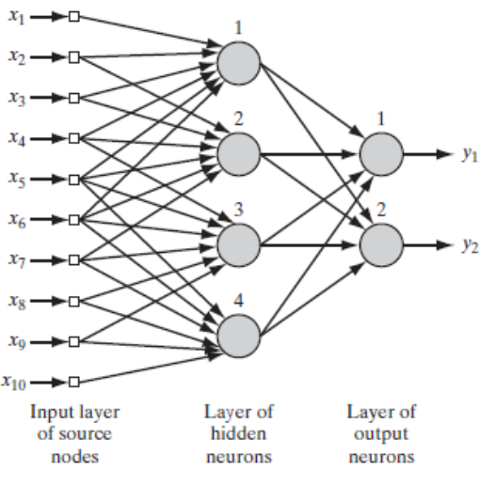
Building prior information into NN design
Examples of how to build prior information into the NN design.
We have ad hoc procedures:
  Restricting the network architecture which is achieved through the use of local connections known as receptive fields.
  Constraining the choice of synaptic weights which is implemented through the use of weight sharing.
Partially connected feedforward network.

Slide 22
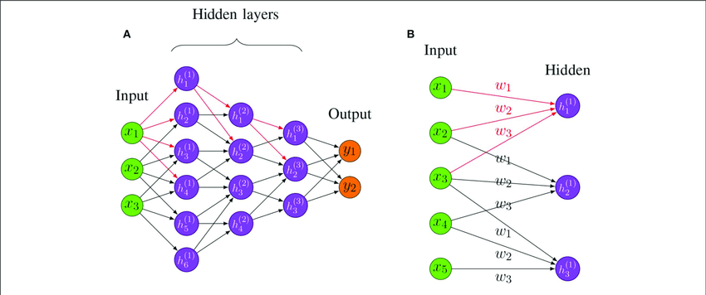
Example: Local connections and weights sharing

Slide 23
Building Invariances into NN Design
Problem to consider during NN design:
  Network trained to detect objects → what if objects appear rotated, translated, scaled, different colors than during training?
  → The classifier should be invariant to these transformations.
How to do that?
  Invariant by structure
  Invariance by training
  Invariant by feature space

Slide 24
Building Invariances into NN Design
Invariant by structure
  Weights of neurons are created so that transformed versions of the same input are forced to produce the same output.
  Disadvantage → the number of synaptic connections becomes prohibitively large even for images of moderate size.
Invariance by training
  Train the network to recognize the image and its rotations (different aspect) views.
  Data Augmentation → Generate more samples from your dataset by applying several type of transformations (rotated, scaled, translated, …).
  Disadvantages → Computational cost, overfitting, …

Slide 25
Building Invariances into NN Design
Invariant by feature space
  Extract features to characterize the essential information content of patterns that are invariant to transformations of the input.
  Advantages
    The number of features applied may be reduced to realistic levels.
    The requirements imposed to the network are relaxed.
    Invariance for all objects with respect to known transformation is assured.
  Disadvantage
    Not easy and should pass by feature engineering step to study the set of features.

Slide 26
Learning Process
Learning can be with a teacher or without a teacher.
  Learning with a teacher can be categorized into supervised and reinforced learning.
Learning with a Teacher → Main steps
  Pattern in dataset are fed into the network
  The error is calculated as the difference between the predicted and real label.
  Weights are updated in backward manner relative to their amount.
  Updates is done until reaching an optimum value

Slide 27
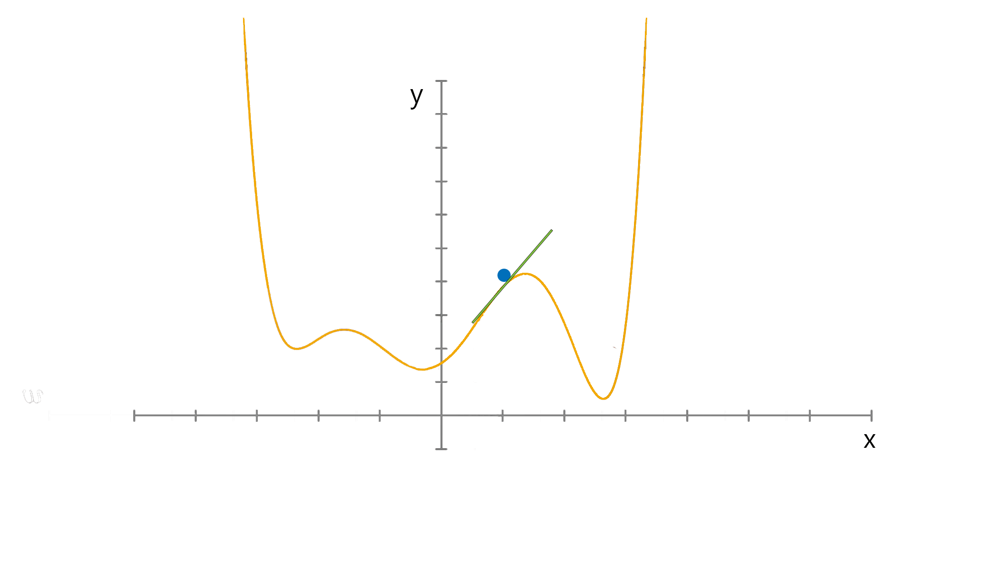
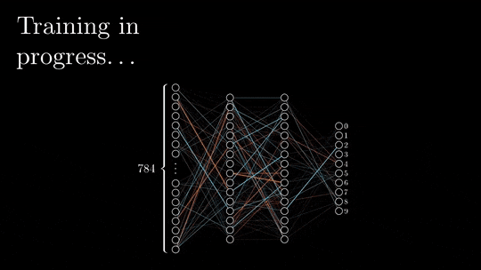
Learning Process
Learning with a Teacher
  Updating the weights is done in the direction of the gradient
  The update is done in one of the three ways:
    Batch-training → one update after processing a batch of samples.
    Stochastic training → one update after processing one individual sample.
    Mini-batch training → one update after processing a small subset of data
Weights updating
Error function

Slide 28
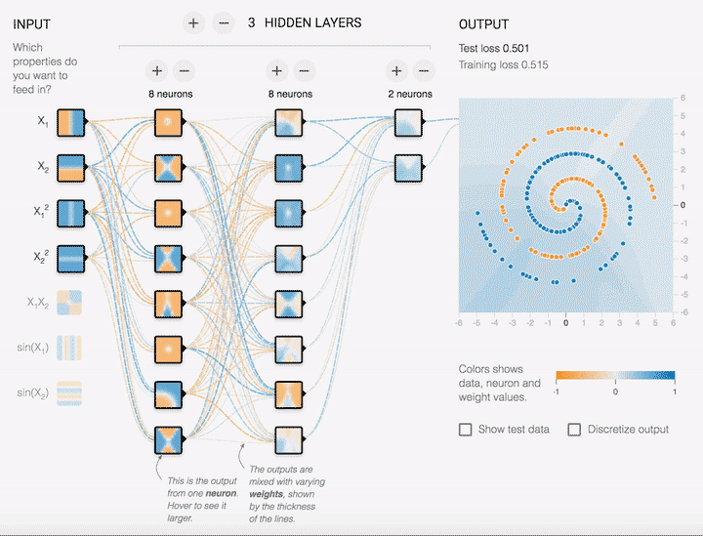
Learning Process

